Slide 1
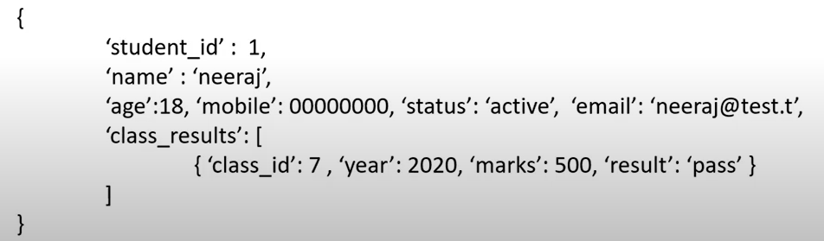
Big Data Analytics with MongoDB
MongoDB Data Model- Collections
Collections is a set of data organized in a JSON format documents. It is also called Binary Encoding of JSON (BSON) documents
Naming a Collection: A name of collection must obey the following rules:
It should not contains $. Or null character
It should not begins with dot (.)
It should not be an empty string
Documents: These are data records that organized in the JSON format

Slide 2
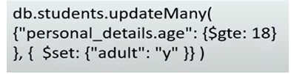
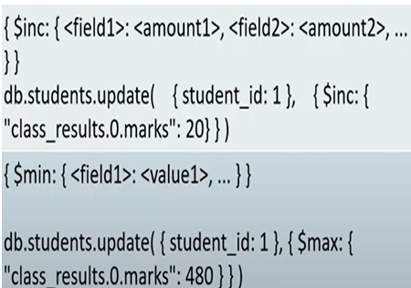
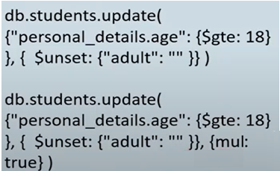
Big Data Analytics with MongoDB
MongoDB - CRUD Commands
Update Query Examples:
Update QUERIES with $rename, $unset Examples:
db.students.updateMany(
{},$rename:{“nme”:”name”})
MongoDB - CRUD Commands
Update Query with $min, $max, $inc Examples:

Slide 3
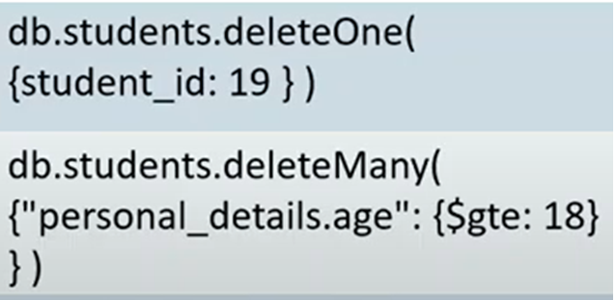
Big Data Analytics with MongoDB
MongoDB - CRUD Commands
Delete Queries with Examples:

Slide 4
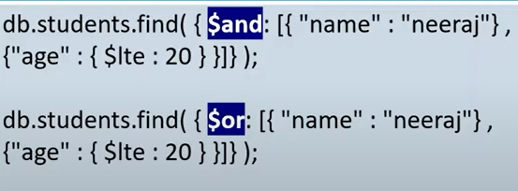
Big Data Analytics with MongoDB
MongoDB - CRUD Commands
Logical Operators Examples:

Slide 5
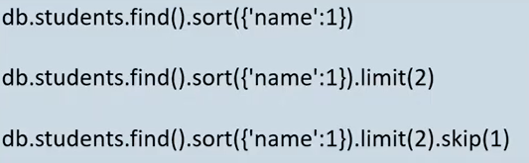

Big Data Analytics with MongoDB
MongoDB - QUERY Commands
Sort, skip, and limit functions Examples:
NOTE: In sorting, “1” stand for ascending order, and “-1” descending order
Nested Fields Examples:

